Slide 1
Introduction / Admin
I am Mandy du Plessis and assisting me today are Gary Douglas and Shawn Wright, who will be handling questions and taking notes on the various inputs, which will be collated and submitted to the COCT as part of the collective Focus Group Process.
This Focus Group is one of the processes that must be completed to advise residents of what a Community Improvement District (CID) is, and to get feedback.
The process for the establishment of the Simon’s Kloof (SK) CID is to achieve a collective participation of at least 60% of the residents in order to move forward. This process will replace the annual contribution that many of you make to both the Fire and Garden Fund (FEGF) and also the SKNW (security) Fund.
Also please watch out for a survey that will require a little of your time but will be invaluable. In addition, the annual report alludes to the AGM that will take place in the coming months.

Slide 2

SIMON’S KLOOF
FOCUS GROUP PRESENTATION IV
VICTORY WAY / CLOSE
19 JULY 2023

Slide 3
What is a City Improvement District (CID)?
A CID is a geographically defined area
where property owners pay additional property rates to fund supplementary municipal services
to improve and upgrade the area
NOTE: IT IS NOT REPLACING CITY SERVICES
PURPOSE OF THE CID
Improves and upgrades areas through through sustainable urban management
Enhances and supplements municipal services
3

Slide 4
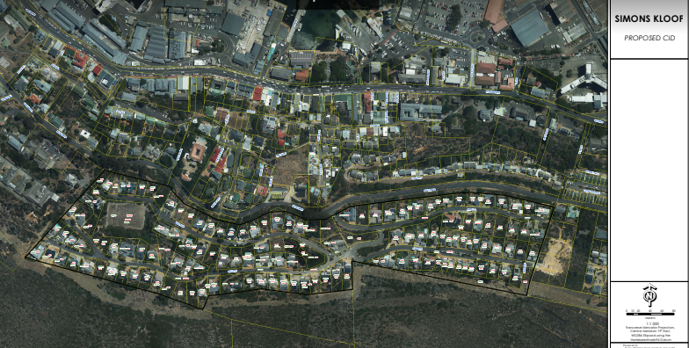
Proposed area for Simon’s Kloof CID

Slide 5
Legal Framework – Mandate for the CoCT
CID By-Law
Municipal Property Rates Act (Section 22 – guides establishment)
Municipal Finance Management Act (Fiscal governance)
Municipal Systems Act (Ability to determine cent-in-the-rand and collect)
SA Constitution (Schedules 4 & 5 – municipal functions)
Companies Act (Governance and accountability as per generic MOI dealing with meeting protocols, operational structure)
CID Policy
Rates Policy (Relief)
Credit Control and Debt Collection Policy (Billing, arrears)
Finance Agreement (Financial reporting and responsibilities)
Any other Act, By-law, Policy and Regulation applicable to CCT
5

Slide 6
What are the benefits of a CID
It’s the pooling of resources in a CID, where property owners can enjoy the collective benefits of a well managed area, with a shared sense of communal pride, and access ito joint initiatives such as a safe neighbourhood for all residents, environmental clearing of alien vegetation, maintenance of street verges and other suggested initiatives which in the end translates into a tangible boost in property values and investments

Slide 7
Critical Components for a successful CID
Transparency and inclusivity
Extensive communication and community participation
Co-ordination, co-operation and commitment (3C’s)
Governance, legislative compliance, administration
Accountability
Oversight and responsibility
Affordability and sustainability
7

Slide 8
What supplementary (top up) services are provided by CIDs?
Focus areas:
Improving Safety in Public Areas
Patrolling/CCTV Cameras/ LPR Cameras ◀︎
Combatting Grime
Environmental initiatives
  Maintaining Street verges ◀︎
Accepting Social responsibilities
Regenerating area through sustained urban management

Slide 9
Value Add of CIDs
Focussed management of area
Service delivery oriented
Environmental awareness
Clean urban environment
Marketing and promoting of area
Creates confidence in property prices
9

Slide 10
Why is the CID Model Attractive to Communities?
Everybody contributes (extensive financial modelling to ensure affordability)
Control over own money
Can only be spent in the CID as per approved Business Plans
Appoint own service providers (competitive process)
Set own standards / service levels
Full community participation (pre and post establishment)
Enhanced municipal services
Guaranteed monthly pay-over from the City
All Additional Rates arrears belong to the City
Fully supported by the City (Political representation as observers and ongoing support from officials)
Area becomes attractive and sought after
Not unlimited lifespan - can dissolve at any time
Pool resources with the City and other organisations

Slide 11
Benefits for the City
Alternative funding solution for urban management
Service delivery oriented
Halt degeneration of distressed areas
Promote economic growth and sustainable development
Stimulate investment in the CID area
Positive social and economic impact
Extends the Integrated Development Plan into communities
Allows the City to use resources optimally to ensure better value for money
Protects the City`s rates base
Improved relationship between the City and community

Slide 12
Funding Model
Community funds establishment process and service delivery
No funding from the City
City pays monthly on budget (97%) based on an approved business plan
City creates a provision for bad debts (3%) from the additional rates levied in the name of the CID
Provision for bad debts is reviewed annually
  Over provision is refunded to qualifying CIDs
Contributions are based on municipal property values
During establishing - additional rate < 25% of rates rate
City determines the rand-in-the-rand per CID and Council approves it as part of the budget process
City concludes a Finance agreement per CID
Regular financial reporting and audited Annual Financial Statements
12

Slide 13
Post Establishment Approval Requirements
5 year Business Plan
Non-Profit Organisation NPO (Company and Intellectual Property Commission registration)
Tax Compliance
VAT registration
Apply for tax exemption
Board of Directors (portfolios)
Supplier registration as a City supplier
Bank account
Website
Political representation on Board (Observer so no voting rights)
Board meetings and keep minutes
Annual General Meetings (AGM)
13

Slide 14
Post Establishment
Management Body must be a Non-Profit Organisation (NPO)
Board of directors manage the NPC (All property owners)
City oversight is imperative for success as CIDs use public funds
  Political Observer appointed by the Mayor attends CID Board meetings
  CID Branch oversees fiscal and corporate governance
  City Service Departments oversees CID supplementary municipal services
  Sub-Councils receive Annual Reports
  CFO can request a forensic audit should it be necessary
Ongoing Tax Compliance
VAT registration
Apply for tax exemption
Register as supplier on Central Supplier Database (CSD) and as a City supplier

Slide 15
Role of the City of Cape Town
Post Establishment
Compliance
Extension of boundaries
Renewal of term
Legislative Compliance (refer legal framework)
Annual reports
Monthly Expenditure Reports (Actual vs Budget)
Review annual budgets
Annual Financial Statements
Mid year performance review
15

Slide 16
Potential Resident Concerns to take CID forward / Risks if we don’t
Concerns:
Steering Committee (capacity, appetite, funding, property owners)
Unsatisfactory arrears profile
Low valuation base
Insufficient support
High rate of objections
Risks:
Becoming part of a larger CID where we lose focus and control of funds
Appetite of current Committee for status quo
16

Slide 17
Timelines + Roll out of SK CID
COCT approved the commencement of the SK CID after receiving a 97.5% Rates Collection Ratio for our area on 2 JUNE 2023
All Processes as per Project Plan for the establishment of SK CID must be submitted by 31 OCTOBER 2023. COCT will evaluate all aspects of the submitted documentation and pronounce on the outcome.
  By 31 Oct 23, following to be achieved: Survey / Public Mtgs / Budgets / 5 year Plan / Voting to achieve 60% (Each step is approved by the COCT
Should the City Approve the SK CID application with all the processes the anticipated implementation date to roll out the SK CID is 1 JULY 2024
The applicable rate based on the latest Municipal value of the respective property will be added to the Monthly Rates Bill under a separate section – CID
Rates collected by COCT are transferred to the SK NPO Account for ongoing maintenance and upkeep according to Business Plan and Budget for Simon’s Kloof Residential Area.

Slide 18
SK CID Estimated Contribution Sliding Scale

Slide 19
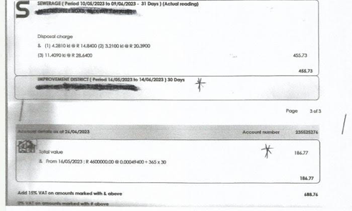
CID Contribution – How it appears on your rates bill

Slide 20
THE SIMON’S KLOOF COMMITTEE
WISHES TO THANK YOU FOR YOUR PARTICIPATION
20

