Slide 1

Simon’s Kloof Community Improvement District NPC
Annual General Meeting
25th November 2025
Simon’s Town – Town Hall

Slide 2

1. Registration

Slide 3
2. Welcome & Apologies
Welcome to our City Representatives Members & Visitors
Ensure you have a Valid Members Ballot Form
Voting shall be by show of hands by Members only.
In Favor of
Against
Abstain.
For Voting validation, please complete Ballot form in line with your vote.
Proxy’s Received:
Gary Douglas
Andries Schaap
Collection of Ballot Papers for validation at meeting conclusion.
Please make notes of questions you want to ask - there will be an opportunity for Q & As at the end of presentation.
Shawn Wright
Clare Watermeyer
Notes:
Welcome city representative remotely David John. Members of S

Slide 4
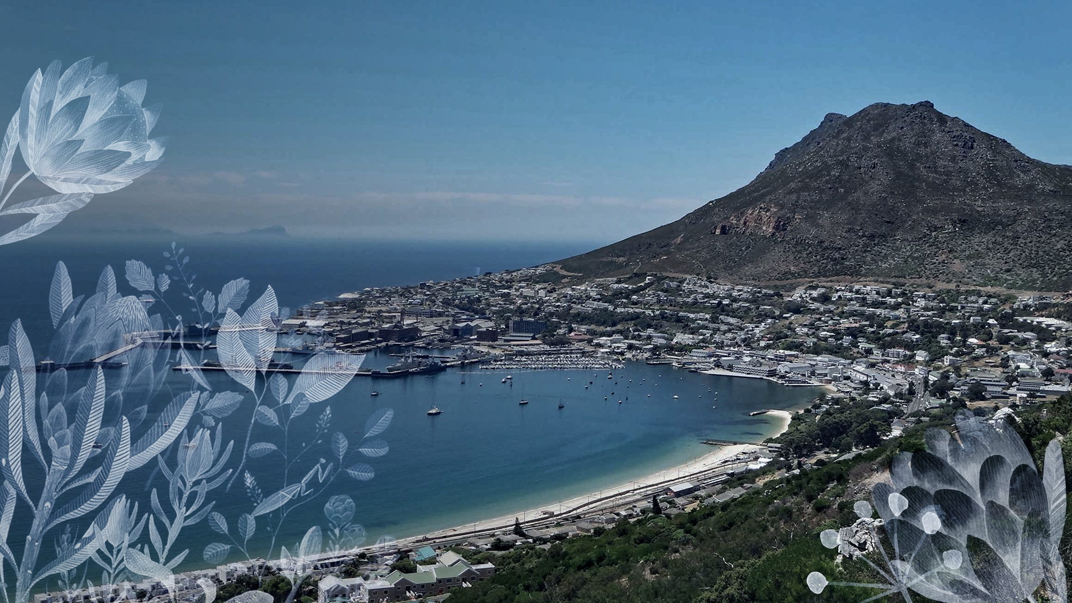
3. Membership

Slide 5
3. Membership
54 Registered Members of the SKCID NPC
COCT has 1 Vote
New 2
Resigned 2
Membership not valid if” the following conditions:
Sells the property ​
in arrears by more than 60 days​
doesn’t attended a members` meeting in person or by proxy for 2 consecutive years.​

Slide 6

4. Quorum & Voting Topics

Slide 7
4. Quorum
15.7.1 The quorum for members' meetings shall be 10% of the members, who must be present in person or by proxy and entitled to vote.
15.7.2 After a quorum has been established for a meeting, or for a matter to be considered at a meeting, the meeting may continue, or the matter may be considered, so long as at least one member with voting rights entitled to be exercised at the meeting, or on that matter, is present at the meeting.
Notes:
We are at X%

Slide 8
4. Voting Topics
Voting for :
Approval of Annual Report 2024/25
Approval of Budget
Approval of Implementation Plan
Appointment of Registered Auditors
Confirmation of Company Secretary
Election of Board
Procedure:
Show of hands
In Favour of
Against
Abstain
Complete Ballot Form for validation

Slide 9

5. Chairperson’s Report

Slide 10
5. Chairperson’s Report
Achieved a clean audit for our 1st financial year.
Focus for 1st year:
set up the NPC so it can operate to deliver on the MOI, implementation plan & budget.
appointment of suitably qualified service providers, contract staff, auditors, company secretary & Directors.
ensured all compliance & regulatory requirements are in place
Delivery on the public safety (security & fire), environmental development & communications objectives.
increasing safety and security.
encouraging the maintenance, vegetation clearance and fire readiness of private and public owned properties within the area.
ensuring a clean and well-maintained public environment.
Notes:
Full Report available of the website.

Slide 11
5. Chairperson’s Report
Engaged with, and built relationships with our varies stakeholders:
SKCID residents,
CoCT,
SANParks
SA Navy
suppliers
Changes in Board
Gary Douglas resigned as Chair & Director 30/4/25
Clair Schaap Interim Chair 1/5/25 – 31/10/25
Andy Robertson appointed as Chair from 1/11/25
Appointment of 2 new Directors
Notes:
Successful and healthy turn around of new directors which is encouraged by city.

Slide 12
5. Chairperson’s Report
Challenges
Resignations and replacement of board members.
Misaligned perceptions within the SK Community regarding the scope of service delivery and allocation of public funds.
We undertake new projects and ongoing maintenance to improve the Simon’s Kloof district and augment safety and security for its members.
We facilitate engagement with city, stakeholders and suppliers through communication, guidance and protocols.
Appreciation & thanks
CoCT Departments & Representees
SKCID Board & Volunteers
Ros Euchas, Caroline Stelling
SK Residents!!
for logging and reporting of issues (C3’s), solving problems, assisting neighbours, volunteering in the garden, fire and communication areas.
Notes:
Ros - Accountant
Caro - Chief Administrator
Thanks to SKCID Board Volunteers
1. We undertake new projects and ongoing maintenance to improve the Simon’s Kloof district and augment safety and security for its members.
2. We facilitate engagement with city, stakeholders and suppliers through communication, guidance and protocols.
Whilst we help to facilitate communications and awareness of individual cases, it must be clear that we are NOT a conduit for communicating with the city, stakeholders and suppliers. We are NOT in a position to force service delivery, and CANNOT hold people accountable unless they are a supplier that we are paying and with whom we have a contract.
We do not settle disputes between residents and property owners.

Slide 13
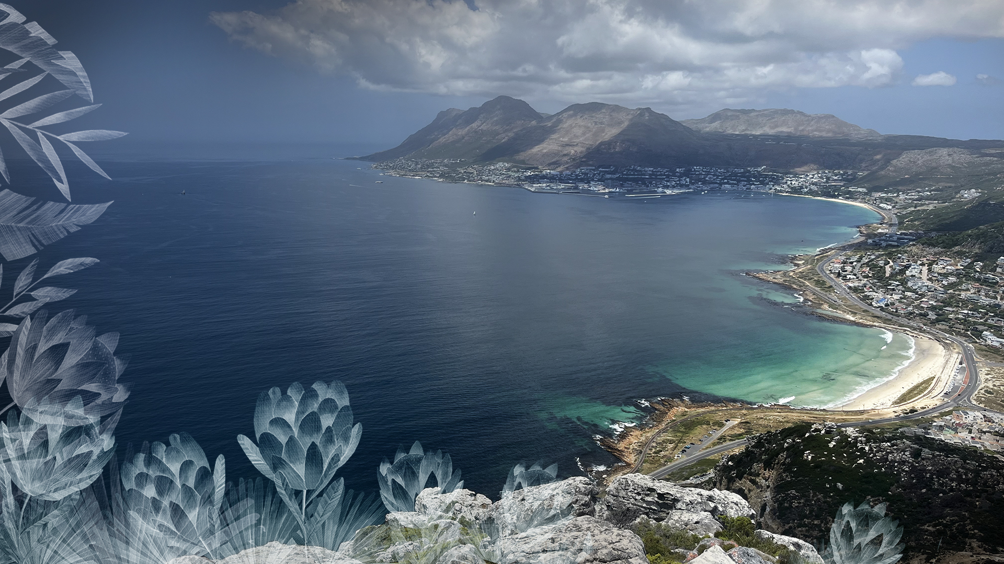
6. Feedback on Operations 2024/25

Slide 14


6. Feedback on Operations
Management and Operations Feedback
appointment of appropriately qualified service providers
IRBA registered auditor and Company Secretary appointed
Members Meeting 28/1/25
quarterly Board meetings
1 out of 4 attended by Political observer
12 Financial reports to the CoCT CID Department
signed Unqualified Annual Financial Statements submitted
built relationships, networks & effective communication with our various stakeholders
Notes:
Andy to introduce portfolios

Slide 15
6. Feedback on Operations
Communications Portfolio Feedback
Communication Plan in place
SKCID website operational
Communications Chanels
Website redesign required for ease of access to updated documents.
Community WhatsApp Groups – 122 active participants
SKCID news broadcast group on WhatsApp – 122 contacts
SK Gazette Newsletter published quarterly
Ongoing Zoom presentations to Property Owners – e.g. Fire Risk Assessment Report

Slide 16
6. Feedback on Operations
Public Safety – Security Feedback
Cameras & Monitering
CCTV: Rollout & Service of 28 Long Range Bullet Cameras 19 SKCID owned | 9 Resident owned & integrated
Camera’s monitored by ISS control room 12 x 7 x 365.
LPR Camera which tracks real time vehicle movement In/ Out of the area
Response
Dedicated ISS branded patrol vehicle operated by ISS, 7pm – 7am, 365 days
Responds to suspicious activity or incidents reported by residents.
Funded by the means of a minimum number of ISS contracted customers.

Slide 17
6. Feedback on Operations
Public Safety – Security Portfolio
Continuous oversight of monitoring equipment
Daily reporting & assessment of cameras with control room
Incidents reporting: to and from the Portfolio Director
Collecting & collating data from authorities and service providers*
Monitor CoCT erfs for vagrants/ dwellings by all
Due diligence and assessment of service providers (PSIRA registered)
Board approval for implementation of CCTV infrastructure
Registration and compliance of monitoring infrastructure with CoCT
* SAPS no longer provides statistics, investigating other sources
Notes:
Nico’s note: Maintain continuous oversight & engagement with regards to security monitoring, daily reporting, collating data and ensuring open comms with authorities and service providers.
Liaising with SKCID board and community for approval and rollout of camera project.
Please get in touch with the Portfolio director for more detail.

Slide 18
6. Feedback on Operations
Public Safety – Security Challenges
Passing of Mr. Manu Choudree of Mach1. Manu was instrumental to the success of the SK Security initiatives & Southern Peninsular security network.
Residents expect the ISS patrol car security personal to investigate potential threats on their properties although reaction security is with another security provider.
Residents need to prioritise their own property security & not rely solely on the security service provider for comprehensive coverage. AND NEED TO ACTIVATE WORKING ALARMS
General increase in crime in Simon’s Town and surrounds
Bin pickers are deemed as a security threat.
Ithuba taking over from IMINI services to remain (updates in Q&A)

Slide 19
6. Feedback on Operations
Public Safety – Fire
Using Fire Risk Assessment & drone footage as the basis to develop strategy and management plan – In Progress.
development of a Fire Committee to focus on Fire Risks and Preparation
03/9/24 Vulcan Wildfire Risk Presentation to property owners
provide information on fire preparedness through a series of Fire Readiness Communications sent to property owners by email and SKCID News WhatsApp group
Engage stakeholders regarding the non-compliance of firebreaks and removal of alien vegetation
SANavy have cleared land of aliens and cut back firebreaks.
CoCT have cleared 13 City owned erfs
16 privately owned stands were cleared
SANParks fire break compliance, firebreak & alien vegitation still to be cleared

Slide 20
6. Feedback on Operations
Public Safety – Fire Portfolio
member of CPFA
quarterly audit of hydrants completed, and issues logged as C3’s
fire Equipment tested annually and working
fire Equipment training held on 23/11/2024, attended by 20 property owners
Challenges
slow response & lack of commitment from public stakeholders: the non clearance of the aliens and firebreaks.
residents want to keep gardens which have overgrown into fire break

Slide 21
6. Feedback on Operations
Environmental Maintenance & Cleansing
Seasonal and rotation plan in place
Engaged the services of a contract Gardener one day a week:
Weeding, watering and maintaining gardens
Clearing debris & overgrowth from the roads, pavements & fire hydrants
Set up of volunteer gardening team
Use of mountain water to water gardens.
Over 40 C3 service requests logged including covering potholes, flooding, Erf clearance, alien vegetation, streetlights, water pressure, road damage, burst pipes, leaking hydrants & fallen trees
Big Thanks to Lorraine & volunteers!

Slide 22

Approval of Annual Report 2024/25 Noting of Audited Financial Statements
Approval of Budget
Approval of Surplus funds
Approval of Implementation Plan
Appointment of Registered Auditors
Confirmation of Company Secretary
Election of Board
7. Voting

Slide 23
2024/25 Financials & Compliance
Revenue Received R368,894
Other Income R114,500 (SKNW Camera Assets)
R176,659 (SKNW & FEGF Fund Donations)
Expensed R179,396
R44,081 Environmental Upgrade
R25,328 Repairs & Maintenance
R32,368 Accounting & Admin
R18,418 Public Safety
R17,082 Seed Capital to SKNW
R8759 Insurance
R9,000 Auditors
R23,360 Other
Surplus For the Year R480,657
All compliance and regulatory items are complete.

Slide 24
2024/25 Financials & Compliance

Slide 25

Approval of Annual Report 2024/25
Please cast your vote!

Slide 26
Approval of Annual Report 2024/25 Noting of Audited Financial Statements
Approval of Budget
Approval of Surplus funds
Approval of Implementation Plan
Appointment of Registered Auditors
Confirmation of Company Secretary
Election of Board
7. Voting

Slide 27
Budget 2026 / 27
As per 5-year plan - Zero increase in budget other than Inflation 7.5%.
Budget reallocations to align budget to actual expenditure.
Budget Breakdown TOTAL R448,488
Core Business R84,300 @ 18.8%
Depreciation R93,140 @ 20.8%
Routine Maintenance R41,642 @ 9.3%
General Expenditure R122,221 @ 27.3%
Projects R9,000 @ 2.0%
Capital Expenditure R85,000 @ 19.0%
Bad Debt Provision R13,185 @ 2.9%

Slide 28
Budget 2026 / 27

Slide 29
Approval of Budget
Please cast your vote!

Slide 30
2024/25 Surplus
Revenue Received R368,894
Other Income R114,500 (SKNW Camera Assets)
R176,659 (SKNW & FEGF Fund Donations)
Expensed R179,396
R44,081 Environmental Upgrade
R25,328 Repairs & Maintenance
R32,368 Accounting & Admin
R18,418 Public Safety
R17,082 Seed Capital to SKNW
R8759 Insurance
R9,000 Auditors
R23,360 Other
Surplus For the Year R480,657
All compliance and regulatory items are complete.
Notes:
@Nico This slide and the subsequent vote might be removed - talking point(s) below:
The City gave us a last minute request to include a vote on surplus.
This is entirely determined by the budget approval.
So you cannot vote against the surplus without nullifying a vote in favour of the budget.
Therefore we ask that if you voted against the budget you clarify by confirming if the surplus was an issue and note accordingly on your ballot paper.

Slide 31
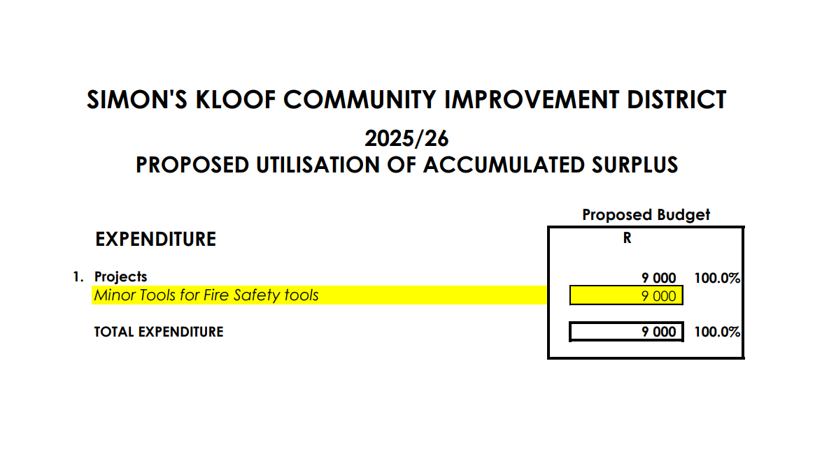
2026/27 Budget Surplus
Notes:
@Nico This slide and the subsequent vote might be removed - talking point(s) below:
The City gave us a last minute request to include a vote on surplus.
This is entirely determined by the budget approval.
So you cannot vote against the surplus without nullifying a vote in favour of the budget.
Therefore we ask that if you voted against the budget you clarify by confirming if the surplus was an issue and note accordingly on your ballot paper.

Slide 32
Approval of Surplus Funds
Please cast your vote!
Notes:
@Nico This slide and the subsequent vote might be removed - talking point(s) below:
The City gave us a last minute request to include a vote on surplus.
This is entirely determined by the budget approval.
So you cannot vote against the surplus without nullifying a vote in favour of the budget.
Therefore we ask that if you voted against the budget you clarify by confirming if the surplus was an issue and note accordingly on your ballot paper.

Slide 33
Approval of Annual Report 2024/25 Noting of Audited Financial Statements
Approval of Budget
Approval of Surplus funds
Approval of Implementation Plan
Appointment of Registered Auditors
Confirmation of Company Secretary
Election of Board
7. Voting

Slide 34
Fire Protection
Projects
Subcommittee & Volunteer program
Deployment Protocol
Projects
Firebreak & Wildland Fire Risk mitigation
Ownership, Roles & Responsibilities
9 STEP Resolution Process
3 x 3 Awareness
Maintenance
Training
Continues risk assessment
Communications & Awareness
Fire Hydrant Checks
Fire Break monitoring & Reporting
Alien Vegetation monitoring, reporting & coordination with Environment portfolio

Slide 35
Security
Projects
Mr. Manu Choudree instrumental to not only the SK Security initiatives but for the entire Southern Peninsular security network. This devastating loss also resulted in the restructuring of Mach1 which delayed the CCTV project. We are pleased to advise the new CCTV Layout Design is ready for implementation as of 1st November 2025
Phase 1 – Runciman Drive backed properties in FY2025/26
Phase 2 - TMNP backed properties in FY 2026/27
Phase 3 - Navy backed properties in FY 2027/28
Phase 4 – St Barts backed properties in FY2028/29
See preliminary camera locations in next slides for Runciman Drive.
Wish to sincerely thank all the SK Residents who have kindly agreed to accommodate cameras on/in their property at zero cost. Without this the project would not be realized.
Notes:
There is very little change in our overall implementation plan. Andrew will talk to a few high level points that will help going forwards.

Slide 36
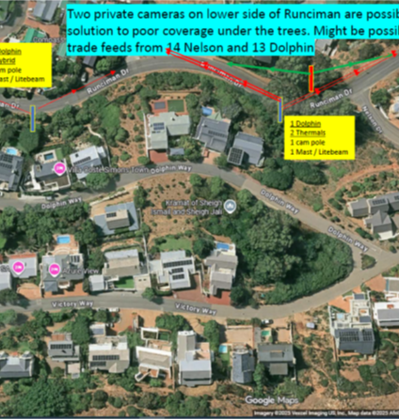
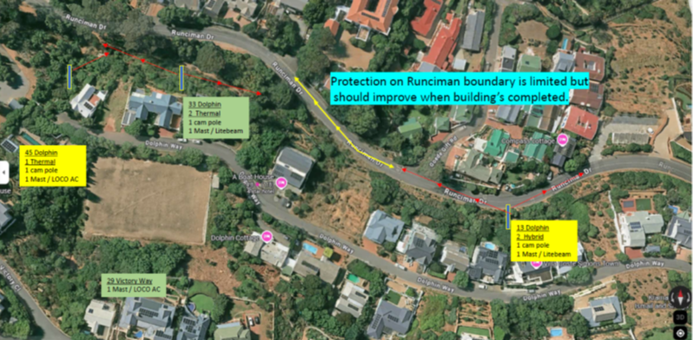
Security
more in Q & A….
Notes:
There is very little change in our overall implementation plan. Andrew will talk to a few high level points that will help going forwards.

Slide 37
Approval of Implementation Plan
Please cast your vote!

Slide 38
Approval of Annual Report 2024/25 Noting of Audited Financial Statements
Approval of Budget
Approval of Surplus funds
Approval of Implementation Plan
Appointment of Registered Auditors
Confirmation of Company Secretary
Election of Board
7. Voting

Slide 39

Appointment of Registered Auditors 2026 / 27
Cecil Kilpin & Company
www.cecilkilpin.co.za

Slide 40
Appointment of Registered Auditors
Please cast your vote!

Slide 41
Approval of Annual Report 2024/25 Noting of Audited Financial Statements
Approval of Budget
Approval of Surplus funds
Approval of Implementation Plan
Appointment of Registered Auditors
Confirmation of Company Secretary
Election of Board
7. Voting

Slide 42
Appointment of Registered Auditors 2026 / 27
Waterford Mews
(Cecil Kilpin & Company)

Slide 43
Confirmation of Company Secretary
Please cast your vote!

Slide 44
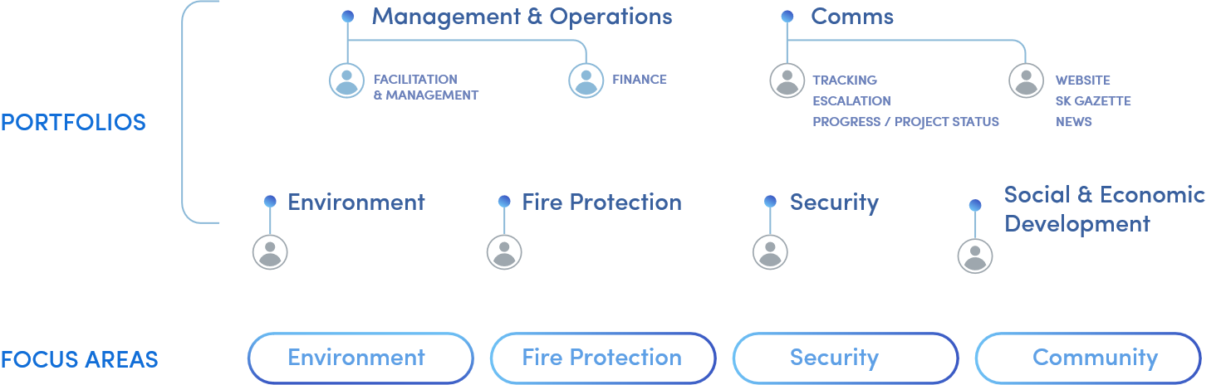
Board Structure

Slide 45
Approval of Annual Report 2024/25 Noting of Audited Financial Statements
Approval of Budget
Approval of Surplus funds
Approval of Implementation Plan
Appointment of Registered Auditors
Confirmation of Company Secretary
Election of Board
7. Voting

Slide 46
Board Structure & Roles
Resigned
Lorraine Goddard
Clair Schaap
Standing for Re-Election
Lorraine Goddard
Nico Panagio
Eric Pelser
Andrew Robertson
Sergio Capellino

Slide 47
Election of Board
Please cast your vote!

Slide 48
7. Questions & Answers

Slide 49

Thank you!

